Slide 1
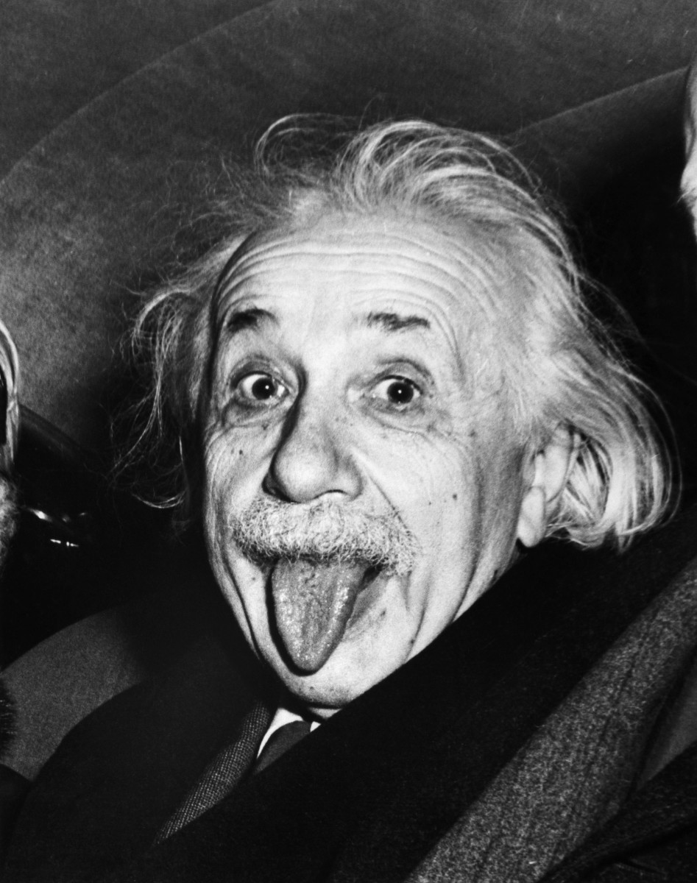
PROJECT 2 TURTLEBOT EINSTEIN
ECE 478, PHONG NGUYEN, ALI BOSHEHRI
Video document:
https://www.youtube.com/playlist?list=PLxiXRkFUM1W4GCAMjMz7DGA7DtuK4A1gv
https://www.youtube.com/watch?v=ZCAw9Dyp-fs&index=5&list=PLxiXRkFUM1W6W14SXuw2-cTAIUkM0oP4m

Slide 2
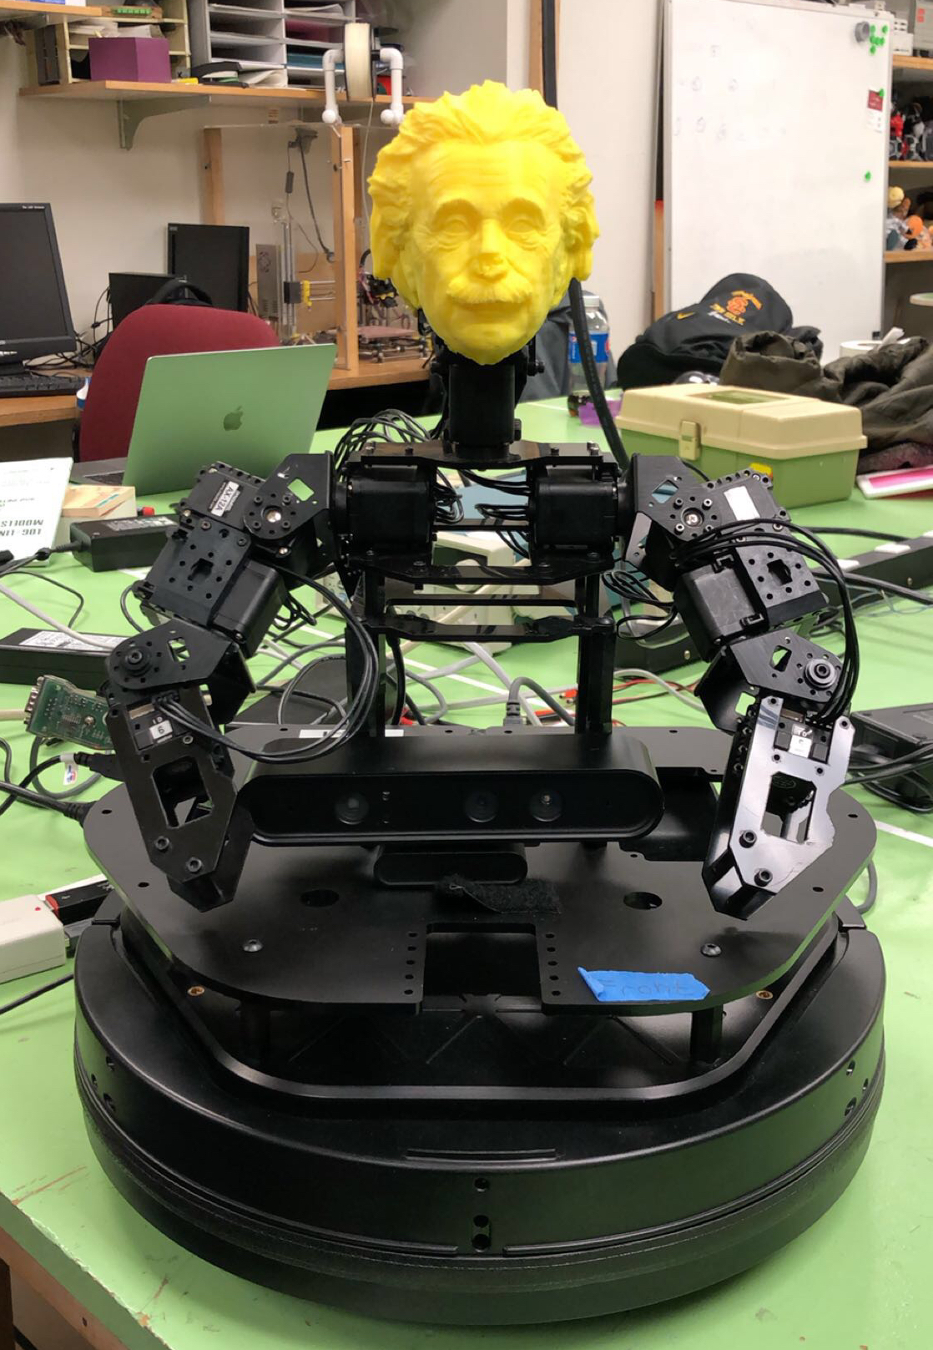
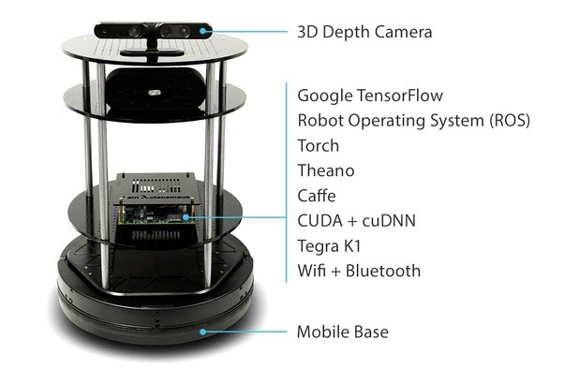
TURTLEBOT PROGRAMING WITH ROS

Slide 3
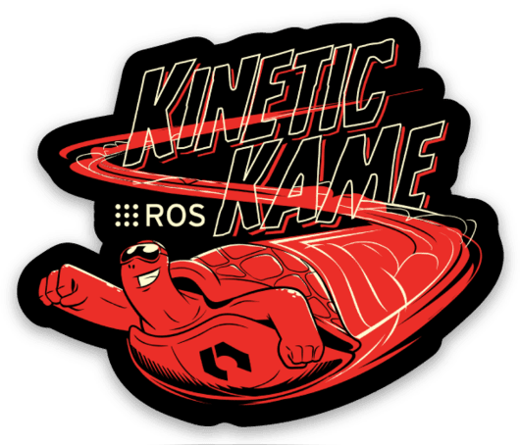
ROS
Software framework for programming robots
Prototypes originated from Stanford AI research in 2007
Consist of 4 things: infrastructure, tools, capabilities, and ecosystem
Open source robotics foundation

Slide 4
PREREQUISITES INSTALLATION
Ubuntu linux 16.04
ROS kinetic + libraries and dependencies
A fairly fast computer if run with simulation
Knowledge of programing in Python or C++

Slide 5
DYNAMIXEL SERVOS
Initializations the servos using RoboPlus 1.0 (Dynamixel Wizard)
Set the limits
Connect to ROS

Slide 6
Objectives
Implement speech recognition into the robot by using Google Dialogflow.
Be able to have a small talk with the robot.
Implement speech synthesis into your robot by using Amazon Polly
We chose German accent to fit Einstein’s character.

Slide 7
Tools
ROS
Google Speech Recognition
DialogFlow
Amazon Polly

Slide 8
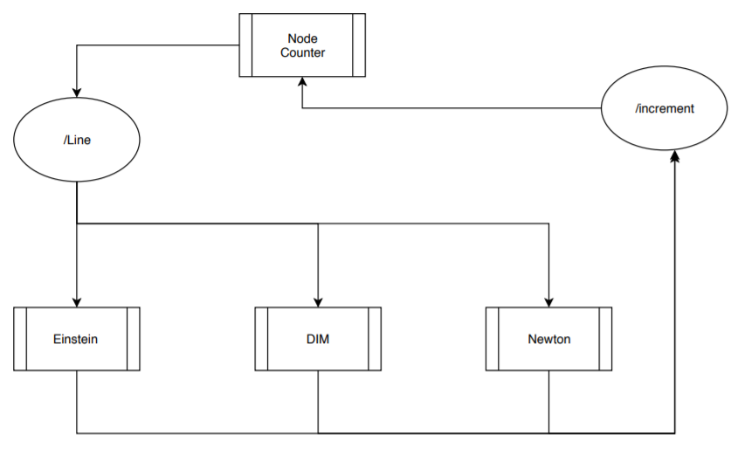

Slide 9
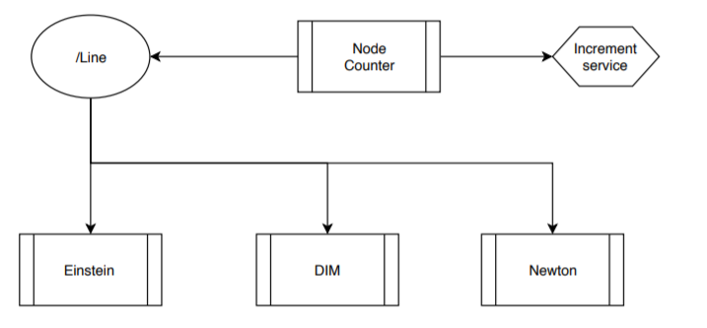

Slide 10
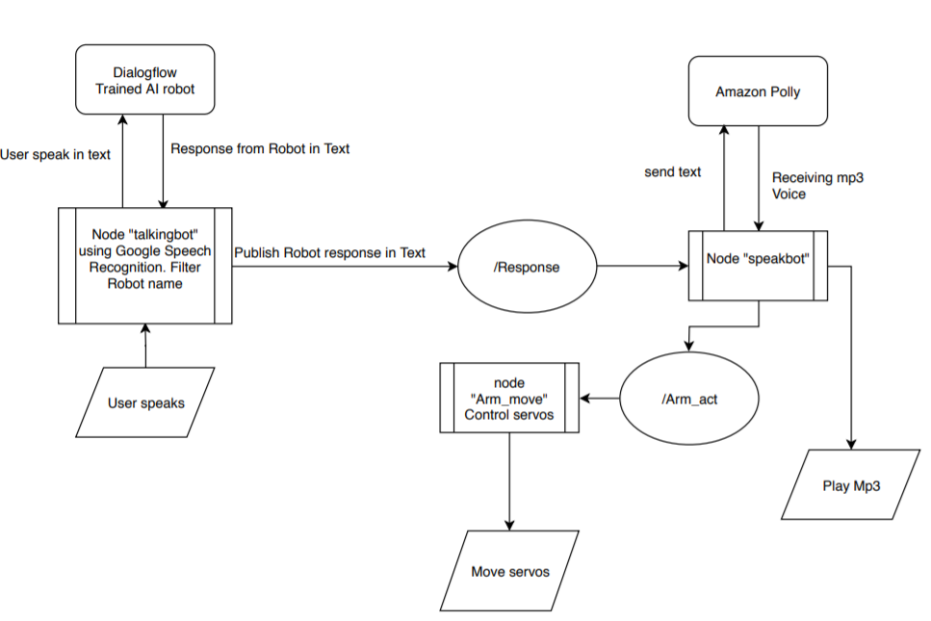

Slide 11
Testing Demo
https://www.youtube.com/watch?v=ZCAw9Dyp-fs&index=5&list=PLxiXRkFUM1W6W14SXuw2-cTAIUkM0oP4m

Slide 12
Questions?
THANK YOU

